Slide 2
United States: From outbreak to program response Karen Hoover, MD, MPH Centers for Disease Control and Prevention July 24, 2019
Notes:
Welcome, and thank you for joining us to talk about HIV data in action and how we use HIV data to prevent infections and improve health. Over the next 20 minutes, we’ll talk about how, in this era of better than ever treatment and prevention options, the HIV prevention landscape is changing, and how we are integrating traditional public health practice and new technology, including the use of molecular data, into HIV prevention and care efforts.

Slide 3
Disclosures
No conflicts of interest to report

Slide 4
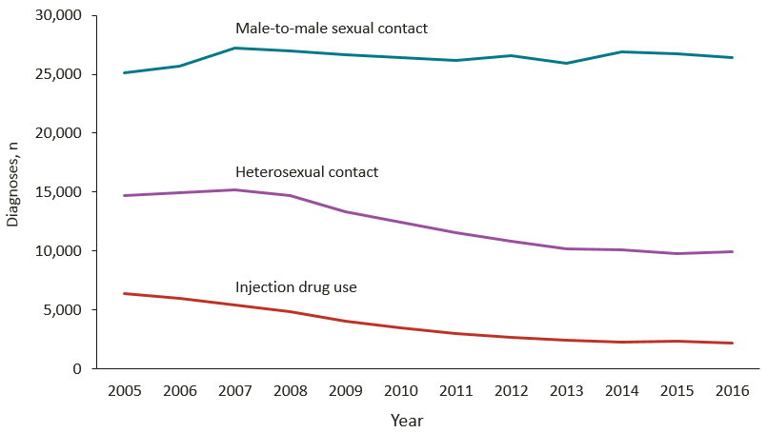
Diagnoses of HIV Infection among Adults and Adolescents, by Transmission Category, 2004–2016—United States and 6 Dependent Areas
IDU transmission
65% decline 2005-2016
2,231 cases in 2016
National HIV Surveillance System (https://www.cdc.gov/hiv/pdf/library/reports/surveillance/cdc-hiv-surveillance-report-2017-vol-29.pdf)
Notes:
So let’s talk a bit about how we use HIV public health data. As a result of strict data use policies, our initial uses of public health HIV data were primarily focused on describing populations… [CLICK ON IMAGE TO BE TAKEN TO A WEB PAGE OUTSIDE OF POWERPOINT]
Although the data are not real, imagine for a moment that each dot on this slide represents a person with newly diagnosed HIV infection. Public health data help us to better understand who is being affected by HIV—for instance…
[CLICK age at diagnosis] How old they were when they found out they had HIV. Here we can see that a lot of people are in their 20s when they find out that they have HIV.
[CLICK race/ethnicity] Their race/ethnicity. This is how we can learn that some groups are disproportionately affected by HIV
[CLICK region] We can also look at what part of the country they live in [PAUSE]
[CLICK transmission category] Or how they likely acquired HIV [PAUSE]
This information can help us to better understand what types of prevention are needed, by whom, and where. It’s also important in identifying disparities, whether those disparities are occurring among racial/ethnic groups, certain parts of the country, or LGBT populations…and this is important in allowing us to determine when certain groups need additional support to overcome barriers they might be facing.
We also know that public health data need to evolve over time. [CLICK sex at birth] For a long time, our reports of public health data have focused on sex at birth. However, we have been working to collect improved data on gender identity [CLICK gender identity], which allows us to better understand the needs of transgender populations.
Additionally, as our prevention options have broadened, we have begun using public health data in new ways. [Click care] Health departments can now use public health data to identify people who appear not to be receiving HIV care. They may need additional support to access HIV care and succeed at maintaining viral suppression. This is sometimes called Data to Care.
[Click year] We can also use public health data to determine when there might be an increase in HIV transmission. For example, we might find that a particular county, which typically has only a few new HIV diagnoses in a typical year, all of a sudden has a lot more than expected. This might signal that there is an outbreak, perhaps like the outbreak of HIV that occurred among people who inject drugs in Scott County, Indiana, in 2015. This would be a signal that public health should respond to try to stop HIV transmission.
[Click none] Now, we have a new tool for identifying situations where there is increased transmission. [Click color by cluster] We can use laboratory information to identify when there are groups of infections that are very similar, much like public health does when looking at outbreaks of tuberculosis or foodborne illness. [Click sort by cluster] For example, here you can see several clusters, or groups of similar infections. For HIV, when we find a group of similar infections, it suggests that they are all part of a common network. These similarities also tell us that HIV likely spread quickly through this network. So let’s zoom in on one of these networks.

Slide 5
Indiana outbreak
Notes:
First, a bit of background about the HIV prevention landscape.

Slide 6
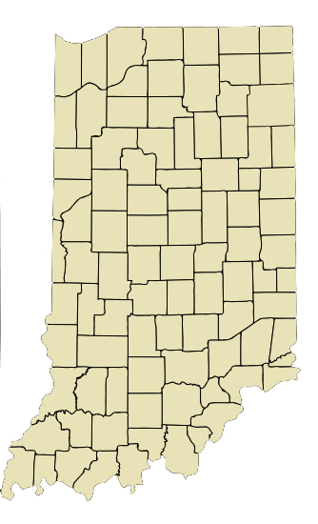
Large HIV outbreak in rural Indiana in 2015
Scott County population of 15,000
5 HIV cases from 2004-2013
11 cases identified in January 2015
First 3 through routine screening
Next 8 through contact tracing
181 HIV cases by November 2015
88% injected extended-release oxymorphone
92% co-infected with HCV
235 HIV cases by June 2019
High prevalence
Scott County: 1.3%
Austin: 7.5%
Conrad et al., MMWR 2015; Peters et al., NEJM 2016
Notes:
So let’s talk a bit about how we use HIV public health data. As a result of strict data use policies, our initial uses of public health HIV data were primarily focused on describing populations… [CLICK ON IMAGE TO BE TAKEN TO A WEB PAGE OUTSIDE OF POWERPOINT]
Although the data are not real, imagine for a moment that each dot on this slide represents a person with newly diagnosed HIV infection. Public health data help us to better understand who is being affected by HIV—for instance…
[CLICK age at diagnosis] How old they were when they found out they had HIV. Here we can see that a lot of people are in their 20s when they find out that they have HIV.
[CLICK race/ethnicity] Their race/ethnicity. This is how we can learn that some groups are disproportionately affected by HIV
[CLICK region] We can also look at what part of the country they live in [PAUSE]
[CLICK transmission category] Or how they likely acquired HIV [PAUSE]
This information can help us to better understand what types of prevention are needed, by whom, and where. It’s also important in identifying disparities, whether those disparities are occurring among racial/ethnic groups, certain parts of the country, or LGBT populations…and this is important in allowing us to determine when certain groups need additional support to overcome barriers they might be facing.
We also know that public health data need to evolve over time. [CLICK sex at birth] For a long time, our reports of public health data have focused on sex at birth. However, we have been working to collect improved data on gender identity [CLICK gender identity], which allows us to better understand the needs of transgender populations.
Additionally, as our prevention options have broadened, we have begun using public health data in new ways. [Click care] Health departments can now use public health data to identify people who appear not to be receiving HIV care. They may need additional support to access HIV care and succeed at maintaining viral suppression. This is sometimes called Data to Care.
[Click year] We can also use public health data to determine when there might be an increase in HIV transmission. For example, we might find that a particular county, which typically has only a few new HIV diagnoses in a typical year, all of a sudden has a lot more than expected. This might signal that there is an outbreak, perhaps like the outbreak of HIV that occurred among people who inject drugs in Scott County, Indiana, in 2015. This would be a signal that public health should respond to try to stop HIV transmission.
[Click none] Now, we have a new tool for identifying situations where there is increased transmission. [Click color by cluster] We can use laboratory information to identify when there are groups of infections that are very similar, much like public health does when looking at outbreaks of tuberculosis or foodborne illness. [Click sort by cluster] For example, here you can see several clusters, or groups of similar infections. For HIV, when we find a group of similar infections, it suggests that they are all part of a common network. These similarities also tell us that HIV likely spread quickly through this network. So let’s zoom in on one of these networks.

Slide 7
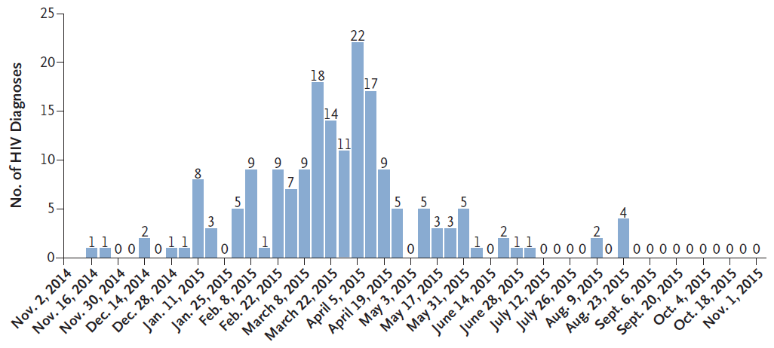
HIV diagnoses peaked in March and April 2015
Peters et al., NEJM 2016
Notes:
So let’s talk a bit about how we use HIV public health data. As a result of strict data use policies, our initial uses of public health HIV data were primarily focused on describing populations… [CLICK ON IMAGE TO BE TAKEN TO A WEB PAGE OUTSIDE OF POWERPOINT]
Although the data are not real, imagine for a moment that each dot on this slide represents a person with newly diagnosed HIV infection. Public health data help us to better understand who is being affected by HIV—for instance…
[CLICK age at diagnosis] How old they were when they found out they had HIV. Here we can see that a lot of people are in their 20s when they find out that they have HIV.
[CLICK race/ethnicity] Their race/ethnicity. This is how we can learn that some groups are disproportionately affected by HIV
[CLICK region] We can also look at what part of the country they live in [PAUSE]
[CLICK transmission category] Or how they likely acquired HIV [PAUSE]
This information can help us to better understand what types of prevention are needed, by whom, and where. It’s also important in identifying disparities, whether those disparities are occurring among racial/ethnic groups, certain parts of the country, or LGBT populations…and this is important in allowing us to determine when certain groups need additional support to overcome barriers they might be facing.
We also know that public health data need to evolve over time. [CLICK sex at birth] For a long time, our reports of public health data have focused on sex at birth. However, we have been working to collect improved data on gender identity [CLICK gender identity], which allows us to better understand the needs of transgender populations.
Additionally, as our prevention options have broadened, we have begun using public health data in new ways. [Click care] Health departments can now use public health data to identify people who appear not to be receiving HIV care. They may need additional support to access HIV care and succeed at maintaining viral suppression. This is sometimes called Data to Care.
[Click year] We can also use public health data to determine when there might be an increase in HIV transmission. For example, we might find that a particular county, which typically has only a few new HIV diagnoses in a typical year, all of a sudden has a lot more than expected. This might signal that there is an outbreak, perhaps like the outbreak of HIV that occurred among people who inject drugs in Scott County, Indiana, in 2015. This would be a signal that public health should respond to try to stop HIV transmission.
[Click none] Now, we have a new tool for identifying situations where there is increased transmission. [Click color by cluster] We can use laboratory information to identify when there are groups of infections that are very similar, much like public health does when looking at outbreaks of tuberculosis or foodborne illness. [Click sort by cluster] For example, here you can see several clusters, or groups of similar infections. For HIV, when we find a group of similar infections, it suggests that they are all part of a common network. These similarities also tell us that HIV likely spread quickly through this network. So let’s zoom in on one of these networks.

Slide 8
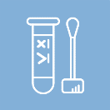
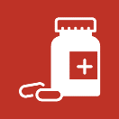
Response
Public health emergency declared March 26
Free HIV and HCV testing implemented
HIV treatment and prevention implemented
Contact tracing conducted
Syringe services program implemented April 4
Community education conducted
Notes:
We are at an exciting time in HIV prevention. Testing is faster and can detect infection earlier. If that test is positive, we have improved treatment options that can save lives and prevent future transmissions. For those that are negative but are at risk, we have effective prevention options, including PrEP and PEP, condom distribution, and syringe service programs. And we now have improved strategies and interventions to reach populations in need of prevention, care, and related services.

Slide 9
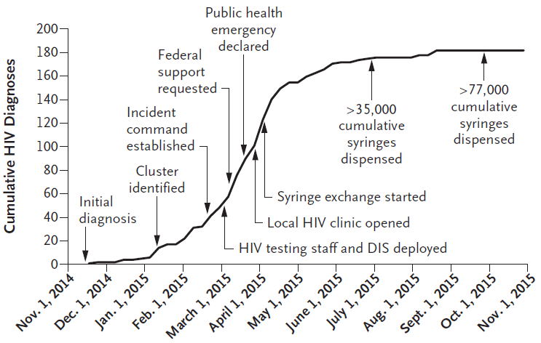
Effective public health response slowed transmission
Peters et al., NEJM 2016
Notes:
So let’s talk a bit about how we use HIV public health data. As a result of strict data use policies, our initial uses of public health HIV data were primarily focused on describing populations… [CLICK ON IMAGE TO BE TAKEN TO A WEB PAGE OUTSIDE OF POWERPOINT]
Although the data are not real, imagine for a moment that each dot on this slide represents a person with newly diagnosed HIV infection. Public health data help us to better understand who is being affected by HIV—for instance…
[CLICK age at diagnosis] How old they were when they found out they had HIV. Here we can see that a lot of people are in their 20s when they find out that they have HIV.
[CLICK race/ethnicity] Their race/ethnicity. This is how we can learn that some groups are disproportionately affected by HIV
[CLICK region] We can also look at what part of the country they live in [PAUSE]
[CLICK transmission category] Or how they likely acquired HIV [PAUSE]
This information can help us to better understand what types of prevention are needed, by whom, and where. It’s also important in identifying disparities, whether those disparities are occurring among racial/ethnic groups, certain parts of the country, or LGBT populations…and this is important in allowing us to determine when certain groups need additional support to overcome barriers they might be facing.
We also know that public health data need to evolve over time. [CLICK sex at birth] For a long time, our reports of public health data have focused on sex at birth. However, we have been working to collect improved data on gender identity [CLICK gender identity], which allows us to better understand the needs of transgender populations.
Additionally, as our prevention options have broadened, we have begun using public health data in new ways. [Click care] Health departments can now use public health data to identify people who appear not to be receiving HIV care. They may need additional support to access HIV care and succeed at maintaining viral suppression. This is sometimes called Data to Care.
[Click year] We can also use public health data to determine when there might be an increase in HIV transmission. For example, we might find that a particular county, which typically has only a few new HIV diagnoses in a typical year, all of a sudden has a lot more than expected. This might signal that there is an outbreak, perhaps like the outbreak of HIV that occurred among people who inject drugs in Scott County, Indiana, in 2015. This would be a signal that public health should respond to try to stop HIV transmission.
[Click none] Now, we have a new tool for identifying situations where there is increased transmission. [Click color by cluster] We can use laboratory information to identify when there are groups of infections that are very similar, much like public health does when looking at outbreaks of tuberculosis or foodborne illness. [Click sort by cluster] For example, here you can see several clusters, or groups of similar infections. For HIV, when we find a group of similar infections, it suggests that they are all part of a common network. These similarities also tell us that HIV likely spread quickly through this network. So let’s zoom in on one of these networks.

Slide 10
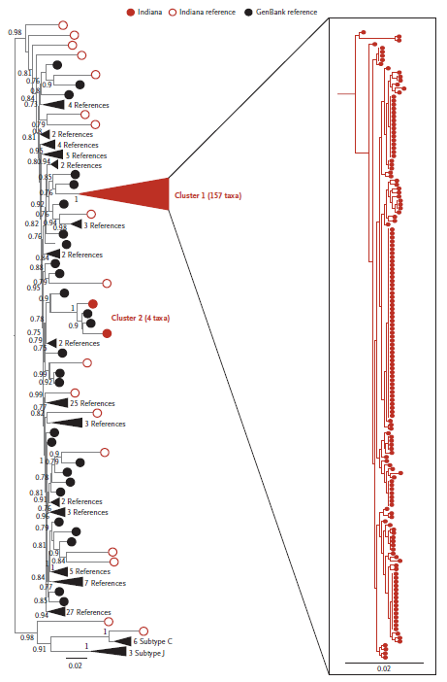
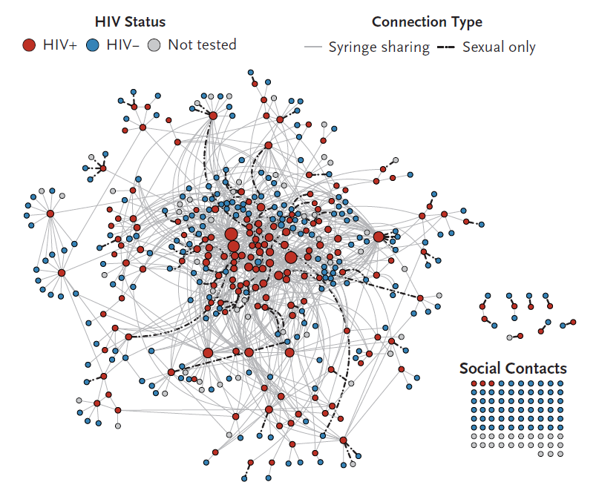
Contact tracing and phylogenetic studies
Peters et al., NEJM 2016
Notes:
So let’s talk a bit about how we use HIV public health data. As a result of strict data use policies, our initial uses of public health HIV data were primarily focused on describing populations… [CLICK ON IMAGE TO BE TAKEN TO A WEB PAGE OUTSIDE OF POWERPOINT]
Although the data are not real, imagine for a moment that each dot on this slide represents a person with newly diagnosed HIV infection. Public health data help us to better understand who is being affected by HIV—for instance…
[CLICK age at diagnosis] How old they were when they found out they had HIV. Here we can see that a lot of people are in their 20s when they find out that they have HIV.
[CLICK race/ethnicity] Their race/ethnicity. This is how we can learn that some groups are disproportionately affected by HIV
[CLICK region] We can also look at what part of the country they live in [PAUSE]
[CLICK transmission category] Or how they likely acquired HIV [PAUSE]
This information can help us to better understand what types of prevention are needed, by whom, and where. It’s also important in identifying disparities, whether those disparities are occurring among racial/ethnic groups, certain parts of the country, or LGBT populations…and this is important in allowing us to determine when certain groups need additional support to overcome barriers they might be facing.
We also know that public health data need to evolve over time. [CLICK sex at birth] For a long time, our reports of public health data have focused on sex at birth. However, we have been working to collect improved data on gender identity [CLICK gender identity], which allows us to better understand the needs of transgender populations.
Additionally, as our prevention options have broadened, we have begun using public health data in new ways. [Click care] Health departments can now use public health data to identify people who appear not to be receiving HIV care. They may need additional support to access HIV care and succeed at maintaining viral suppression. This is sometimes called Data to Care.
[Click year] We can also use public health data to determine when there might be an increase in HIV transmission. For example, we might find that a particular county, which typically has only a few new HIV diagnoses in a typical year, all of a sudden has a lot more than expected. This might signal that there is an outbreak, perhaps like the outbreak of HIV that occurred among people who inject drugs in Scott County, Indiana, in 2015. This would be a signal that public health should respond to try to stop HIV transmission.
[Click none] Now, we have a new tool for identifying situations where there is increased transmission. [Click color by cluster] We can use laboratory information to identify when there are groups of infections that are very similar, much like public health does when looking at outbreaks of tuberculosis or foodborne illness. [Click sort by cluster] For example, here you can see several clusters, or groups of similar infections. For HIV, when we find a group of similar infections, it suggests that they are all part of a common network. These similarities also tell us that HIV likely spread quickly through this network. So let’s zoom in on one of these networks.

Slide 11
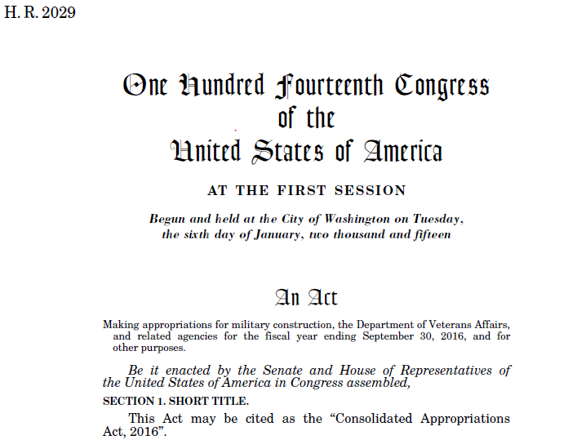
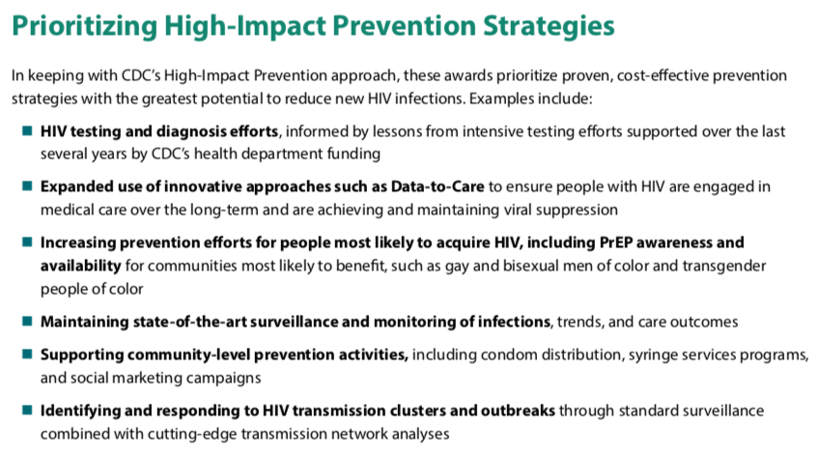
Federal funding for SSPs and outbreak responses
https://www.cdc.gov/hiv/funding/announcements/ps18-1802

Slide 12
Other U.S. outbreaks
Notes:
First, a bit of background about the HIV prevention landscape.

Slide 13
Ongoing outbreak investigations and responses
Northeastern Massachusetts 2015-2018
129 cases
IDU, homelessness, incarceration, exchanging sex for drugs
West Virginia 2015-2017
57 cases
MSM, IDU
Northern Kentucky and Ohio 2017-2018
135 cases
IDU, homelessness/unstable housing, incarceration
West Virginia 2019
Ongoing

Slide 14
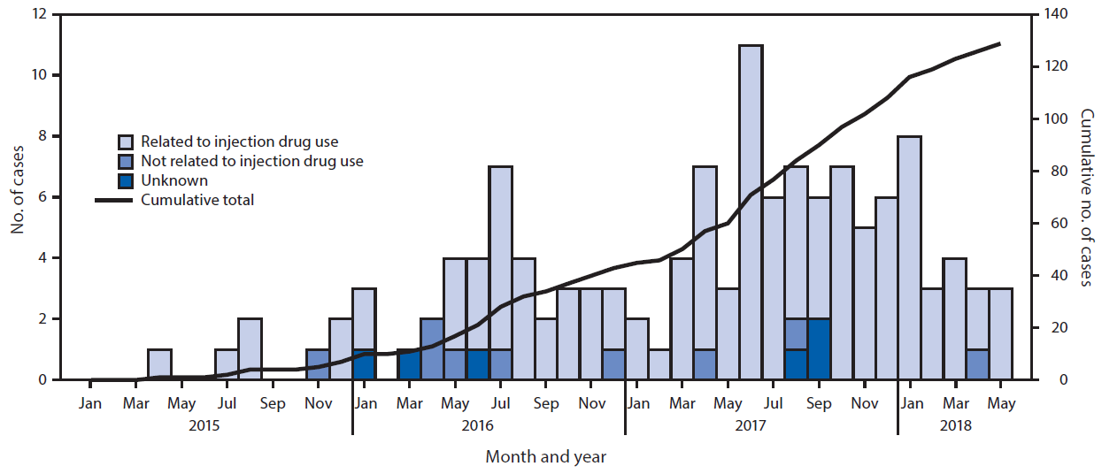
HIV diagnoses in Massachusetts 2015-2018
Cranston et al., MMWR 2019

Slide 15
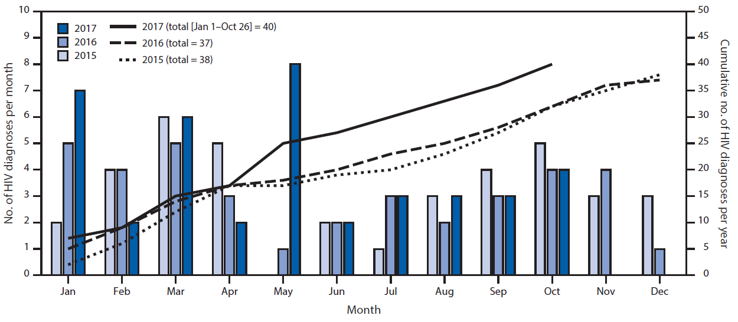
HIV diagnoses in West Virginia 2015-2017
Evans et al., MMWR 2018

Slide 16
Outbreak detection and response
Notes:
First, a bit of background about the HIV prevention landscape.

Slide 17
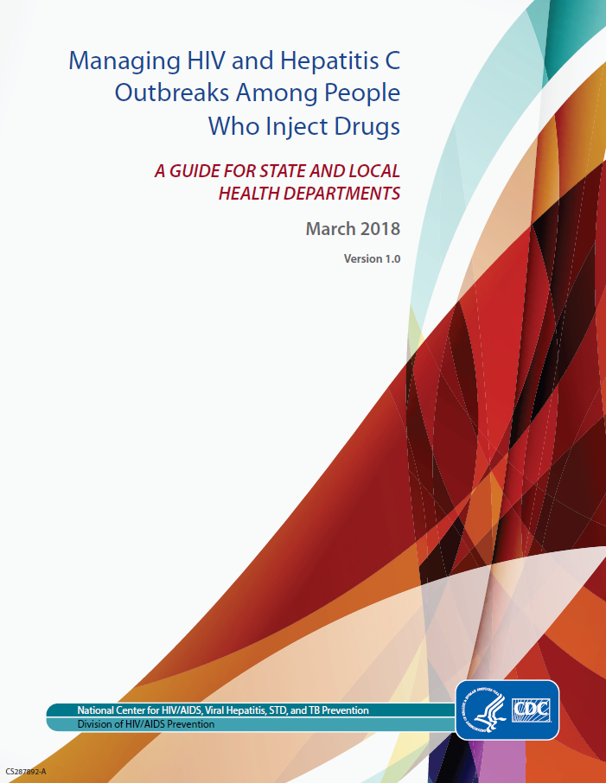
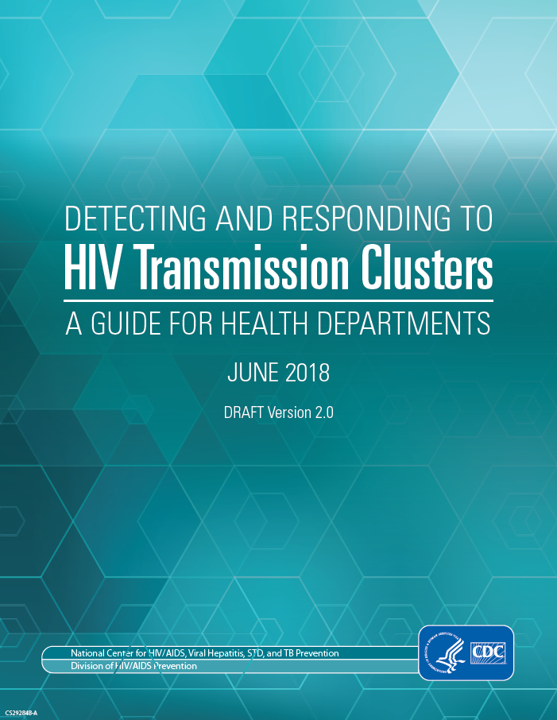
Guides for outbreak investigation and response
CDC (https://www.cdc.gov/hiv/pdf/programresources/guidance/cluster-outbreak/cdc-hiv-hcv-pwid-guide.pdf)
NACCHO (https://www.naccho.org/uploads/downloadable-resources/LENOWISCO-Project-Report_2018_FINAL.pdf)
CDC (https://www.cdc.gov/hiv/pdf/funding/announcements/ps18-1802/CDC-HIV-PS18-1802-AttachmentE-Detecting-Investigating-and-Responding-to-HIV-Transmission-Clusters.pdf)

Slide 18
Outbreak preparedness and detection
Assess capacity to detect outbreak
Develop outbreak criteria and response threshold
Establish healthcare capacity
Develop protocols to refer to medical care
Develop protocols to refer to mental health and substance use treatment
Outbreak investigation
Create case definition for confirmed, probable, and possible cases
Conduct contact tracing
Conduct HIV testing (EDs, substance use treatment centers, jails)
Use HIV testing methods to diagnose acute infection and genetic sequences
Outbreak response
Use Incident Command System principals to manage outbreak
Engage public safety, especially law enforcement
Engage community based organizations
Refer to medical services, MAT, and support services
Refer to SSPs
CDC (https://www.cdc.gov/hiv/pdf/programresources/guidance/cluster-outbreak/cdc-hiv-hcv-pwid-checklist.pdf)
Notes:
We are at an exciting time in HIV prevention. Testing is faster and can detect infection earlier. If that test is positive, we have improved treatment options that can save lives and prevent future transmissions. For those that are negative but are at risk, we have effective prevention options, including PrEP and PEP, condom distribution, and syringe service programs. And we now have improved strategies and interventions to reach populations in need of prevention, care, and related services.

Slide 19
HHS (https://www.hiv.gov/federal-response/ending-the-hiv-epidemic/overview)
Notes:
We are at an exciting time in HIV prevention. Testing is faster and can detect infection earlier. If that test is positive, we have improved treatment options that can save lives and prevent future transmissions. For those that are negative but are at risk, we have effective prevention options, including PrEP and PEP, condom distribution, and syringe service programs. And we now have improved strategies and interventions to reach populations in need of prevention, care, and related services.

Slide 20
Questions
Notes:
Now we’ll begin the discussion portion of our webinar. First, we’d like to use an online polling system, Mentimeter, to get the conversation started.
If you have questions, type them into the chat box.

